Slide 1
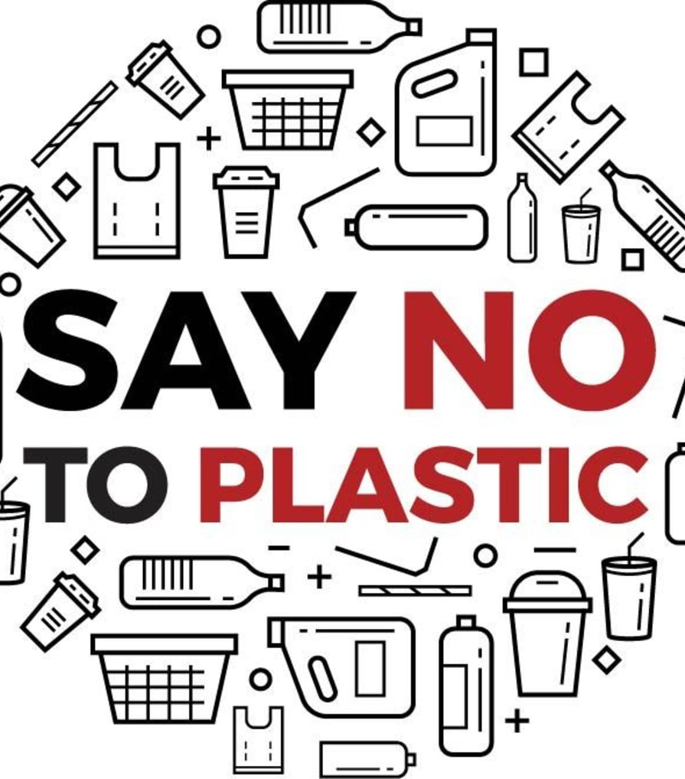
St. Mark’s Church-in-the Bowery
PRESERVING CREATION COMMITTEE
February 16, 2020

Slide 2
In the beginning God created the heavens and the earth. ... And God said, "Let the water under the sky be gathered to one place, and let dry ground appear." And it was so. God called the dry ground "land," and the gathered waters he called "seas." And God saw that it was good.

Slide 3
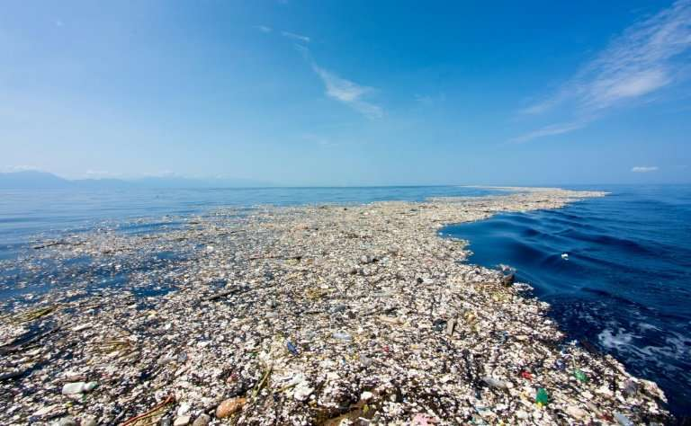
What happened?
Let’s test our knowledge . . .

Slide 4
1. Approximately, Americans use how many plastic drinking straws per day?
25,000
100,000
250,000,000
500,000,000

Slide 5
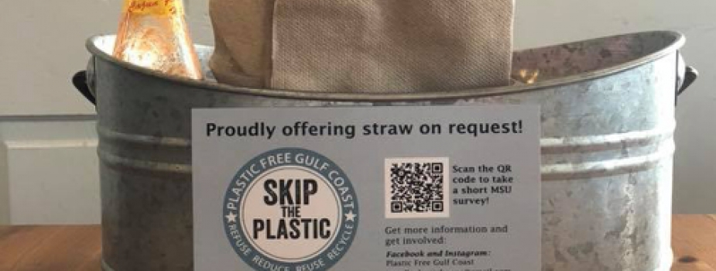
Answer: D – 500 million
On average, Americans use 1.6 plastic drinking straws every day, totally 500 million per day. What can you do? REFUSE straws. URGE eateries to stop giving them out. Or bring your own reusable straw.

Slide 6
2. About how many plastic grocery bags do Americans throw away each year?
10 million
500 million
1 billion
100 billion

Slide 7
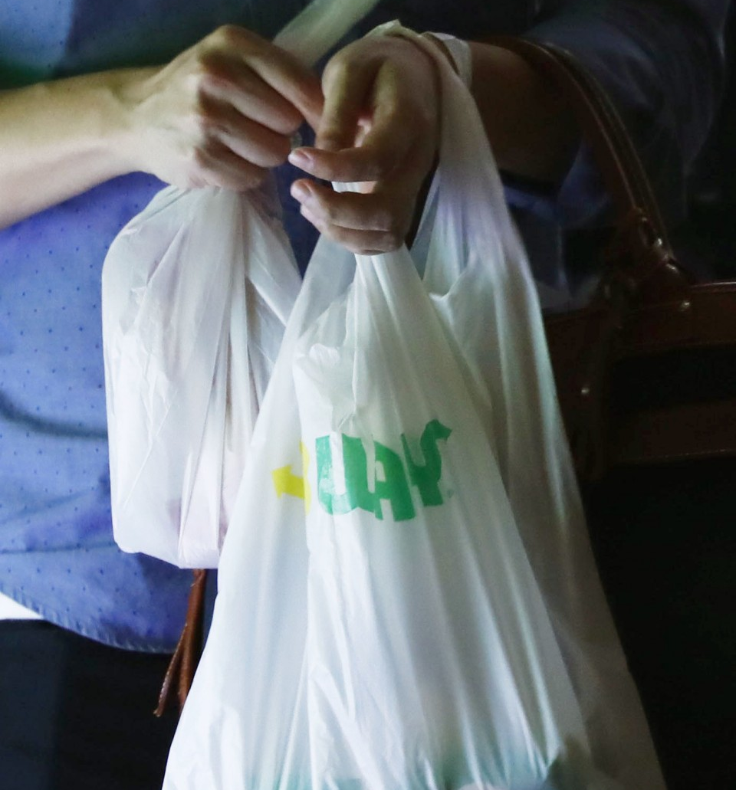
ANSWER: D - 100 billion plastic grocery bags each year
These bags take years to break up but, in the meantime, they are crowding landfills, clogging drains, and making their way into waterways.

Slide 8
3. On average, how long is a plastic bag used by a person before being thrown away?
12 minutes
1 hour
1 day
1 week

Slide 9
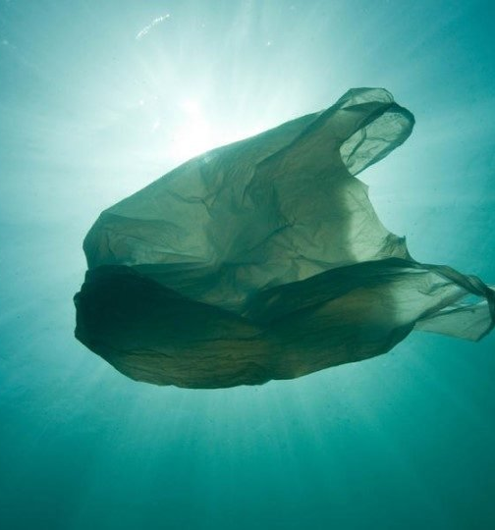
ANSWER: A – 12 minutes
Globally, one million plastic bags are used per minute and 1% are recycled. Most of them make their way to the ocean where they can take up to 20 years to break into tiny pieces.

Slide 10
4. What percent of plastic does the U.S. recycle?
A) 9%
B) 16%
C) 27%
D) 38%

Slide 11
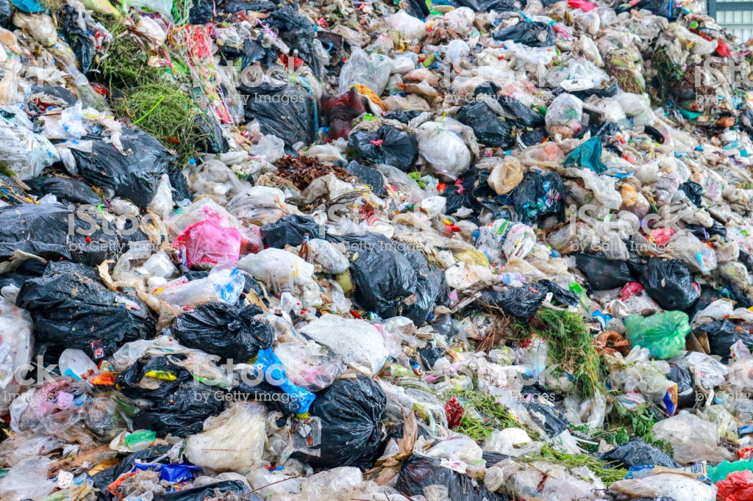
ANSWER: A - 9% of 6.3 billion metric tons
If current production and management trends continue worldwide, 12 billion metric tons of plastic waste will end up in landfills or the ocean by 2050.

Slide 12
5. What percentage of U.S. crude oil consumption does plastic production account for?
1%
5%
20%
None. Plastic is not made using oil

Slide 13
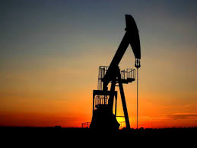
ANSWER: A – 5%
This may not seem like a lot but for the world’s largest consumer of petroleum, that’s equivalent to 330 million barrels of oil a year.

Slide 14
6. Where does the majority of plastic waste end up?
Oceans
Burned for energy
Landfills
Recycled

Slide 15
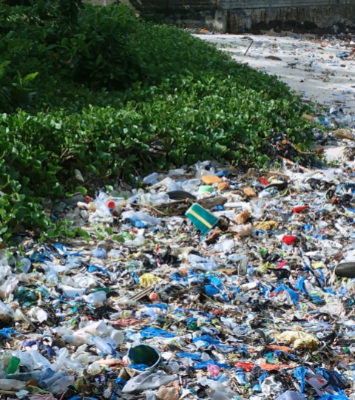
ANSWER: A - OCEANS
While some makes its way to landfills and recycling centers, a majority of it ends up in the ocean through deliberate dumping of garbage into waterways, inefficient waste infrastructure, and simple littering.

Slide 16
It is biodegradable so it eventually disintegrates.
It never full goes away; it just breaks into little pieces.
It falls to the bottom.
It provides food for fish to eat
7. What happens to plastic that reaches the ocean?

Slide 17
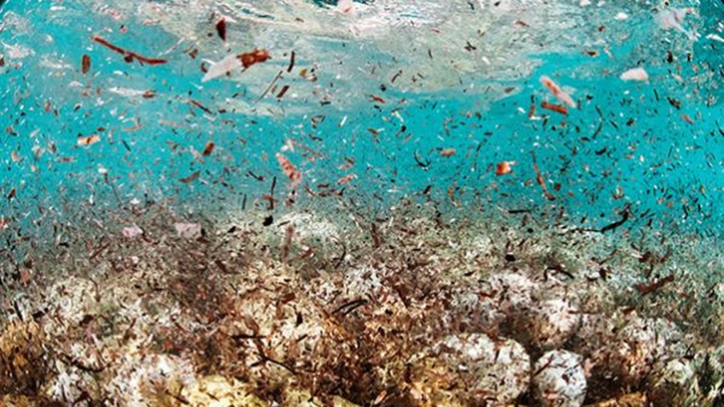
ANSWER: B
Plastic never goes away. Sunlight and ocean waves cause plastic to break down into smaller and smaller particles, but they never completely biodegrade.

Slide 18
8. How many pounds of plastic are estimated to go into the ocean every year?
8 million tons
Five grocery bags per every foot of coastline around the globe.
Enough to circle the equator 10.5 times
Both A and B

Slide 19
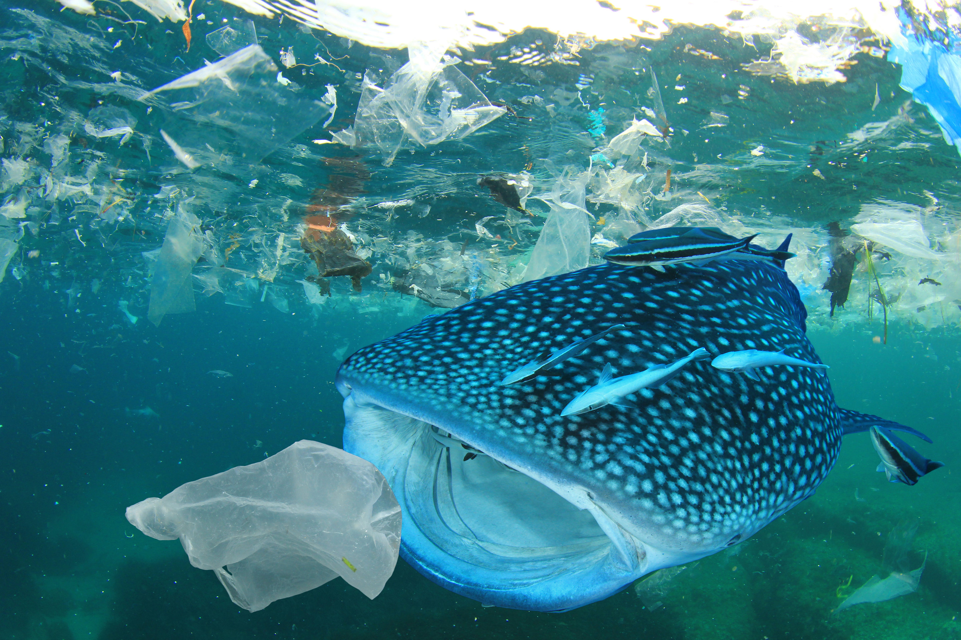
ANSWER: Both A and B
Plastic waste has a devastating impact on marine life. If nothing is done, the amount will double by 2030.

Slide 20
9. By what year will plastic outweigh fish in the ocean, pound for pound?
2020
2050
2250
3000

Slide 21
ANSWER: B – Plastic will outweigh fish in ocean by 2050
There are over 150 million tons of plastic in the oceans today. That is about one ton of plastic for every three tons of fish.

Slide 22
10. There are 5.1 trillion microplastic particles in the ocean today—500 times more than the number of stars in our galaxy.
True
False

Slide 23
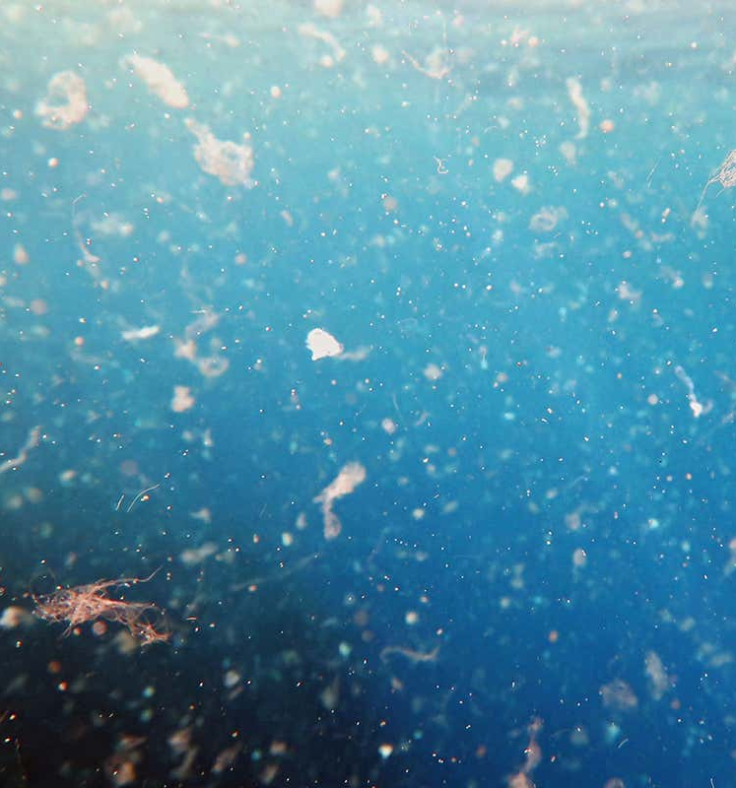
ANSWER: A - True
Most ocean plastic breaks up into tiny particles from millimeters to micrometers in size. These particles are injested by a broad range of species—from ocean plankton to humans. Microfibers have been found in lakes, rivers and freshwater beaches that appear pristine, and in freshwater fish.

Slide 24
11. What percentage of emitted carbon dioxide is absorbed by the oceans?
10%
40%
50%
77%

Slide 25
ANSWER: B - 40% since beginning of Industrial Revolution
While this has slowed global warming, it has made oceans more acidic, harming marine life by bleaching coral reefs and dissolving the shells of crustaceans and shellfish.

Slide 26
12. How much trash does NYC recycle?
40% residential, 52% business
18% residential, 25% business
11% residential, 18% business
12% residential, 65% business

Slide 27
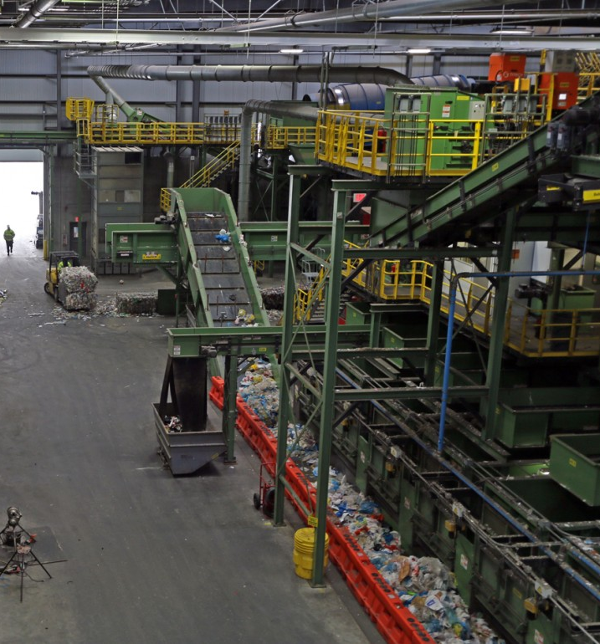
ANSWER: B
According to the NYC Department of Sanitation, NYC recycles only about 20% of its garbage. This compares to 50% in cities like San Francisco and Seattle.

Slide 28
13. What percentage of ALL recyclable material in NYC is actually “captured” for recycling?
8%
53%
44%
20%

Slide 29
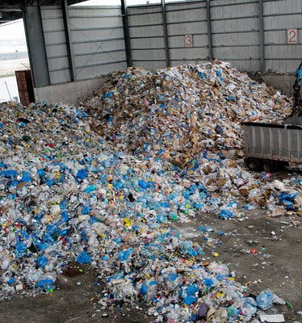
ANSWER: C - 44% of ALL recyclables are “captured”
56% goes to landfills. Capture rates for various recyclable materials vary from 5% to 75%.

Slide 30
14. What percent of rigid plastic (cups, plates, cutlery) is captured for recycling?
12%
37%
5%
21%

Slide 31
ANSWER: C - 5%
Only 5% of plastic dishware – rigid items like cups, plates and cutlery – is captured for recycling, the lowest capture rate for all recyclables.

Slide 32
15. What recyclable item has the highest rate of “capture” for recycling in NYC?
Paper
Cardboard
Aluminum
Glass

Slide 33
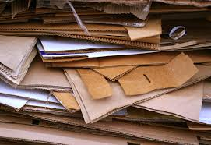
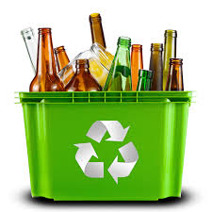
ANSWER: D
75% of container glass is captured for recycling. A close second is cardboard at 71%. NYC makes money on glass and cardboard recycling.

Slide 34
16. A number in the arrows at the bottom of a container means the container is recyclable.
TRUE
FALSE

Slide 35
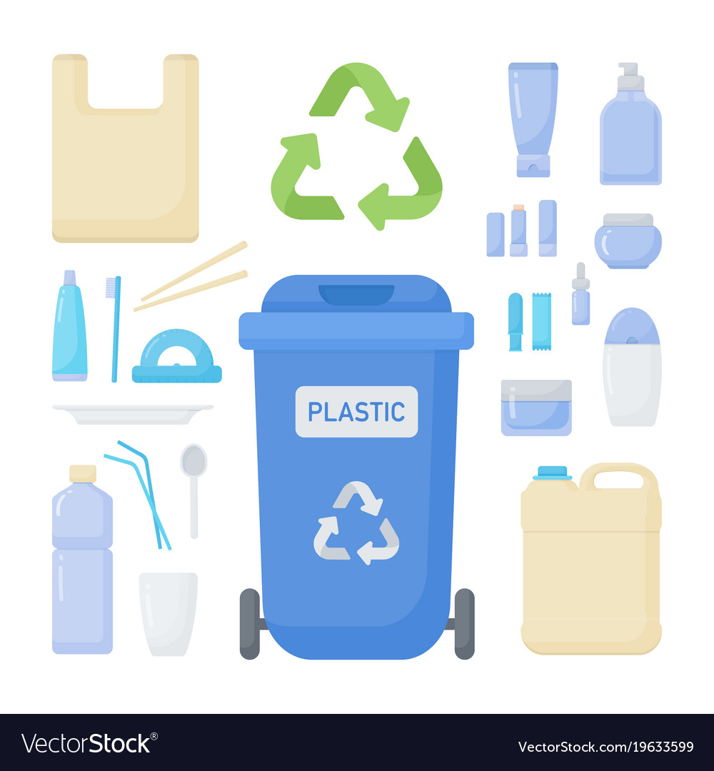
ANSWER: B – numbers indicate the type of plastic only
#1 (water bottles) and #2 (laundry, milk bottles) are generally recyclable.
#s 3, 4, 5 and 7, are made of a mix of different kinds of plastics and are generally not recyclable.

Slide 36
17. What constitutes the largest percentage of potentially recyclable material in NYC?
Plastic
Paper and cardboard
Food waste
Aluminum and other metals

Slide 37
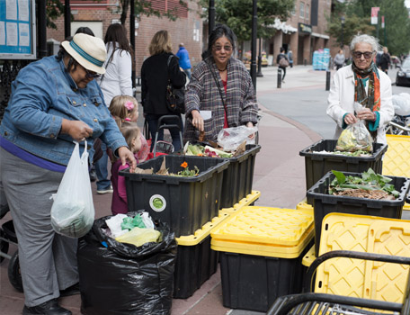
ANSWER: C – one-third of residential waste is food scraps
Food scraps can be composted and turned into fertilizers or biogas. The city’s composting program has stalled. Only the largest restaurants are required to separate food scraps. Experts say money is the problem – composting currently costs far more than it can earn.

Slide 38
18. NY State’s ban on single-use plastics takes effect Mar. 1, 2020. Which of these items are excluded?
Plastic bags used by restaurants
Plastic bags for bulk items (vegetables, fruits, etc.)
Garment bags at dry cleaners
Trash bags and recycling bags
All of the above.

Slide 39
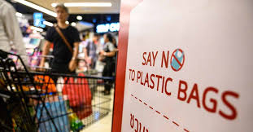
ANSWER: E – All of the above
The NYS ban does not eliminate all single-use plastic bags. It is estimated that NYS uses 23 billion plastic bags each year, 50% of which end up in landfills, waterways or as trash. It is estimated that the ban will eliminate 12 billion gallons of oil used to make bags.

Slide 40
19. How many U.S. states have passed plastic bans?
6
8
11
14

Slide 41
ANSWER: B – 8 States
California
Connecticut
Delaware
Hawaii
Maine
New York
Oregon
Vermont

Slide 42
20. How many U.S. states have passed laws prohibiting local areas from banning plastic bags?
4
11
17
30

Slide 43
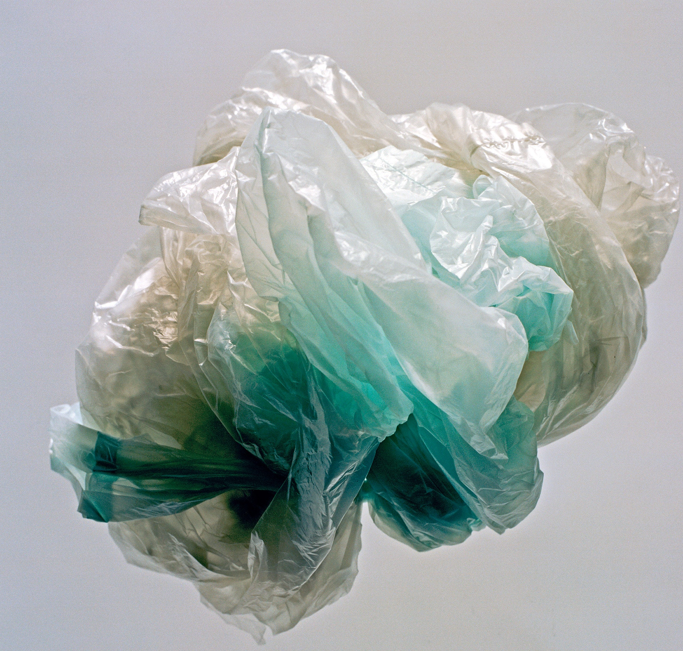
ANSWER: C – 17 states
After hundreds of local jurisdictions enacted local bans on single-use plastic bags, 17 states caved into pressure from the plastic industry to preempt these laws.

